Slide 1

Energy Market and Battery Optimization
Group 13
Cynthia, Gerry, Gilbert, Karina, Yuhong

Slide 2

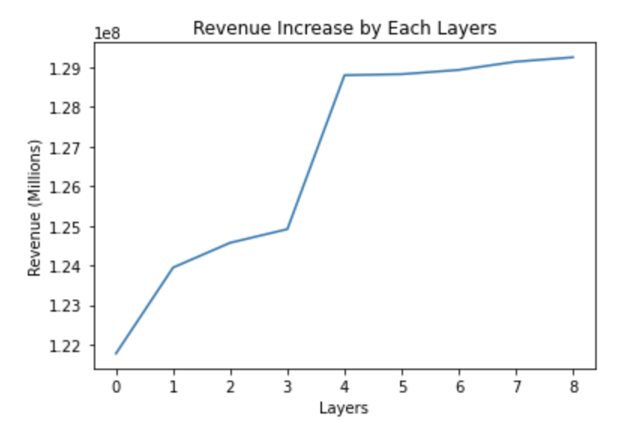
Optimization Algorithm Performance

Slide 3

Algorithm Outline
Moving Average
Region Maximization
Loss Removal
Period Maximization
Stationary Maximization
Action Shift

Slide 4

PERFECT FUTURE PRICE VISIBILITY
MANDATORY TASK

Slide 5

Moving Average

Slide 6
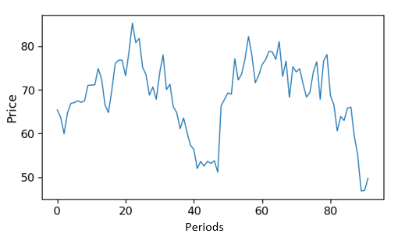
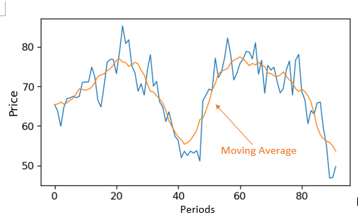
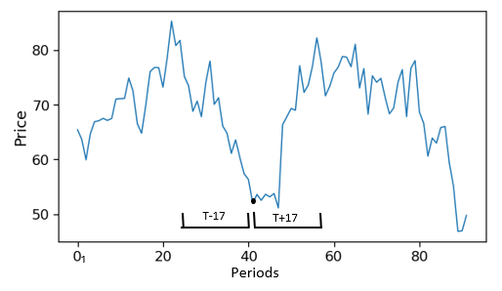
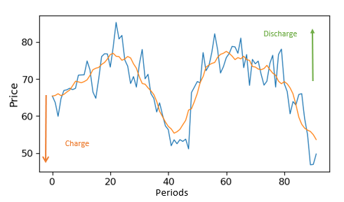
1.
3.
2.
4.
Notes:
Question : where did we get 17?

Slide 7

Region Maximization

Slide 8





= 12 candies
BUYS
SELLS
$5
/ 5 🍬
$3
/ 5 🍬
= 5 candies
Notes:
To illustrate how the region maximisation model works, imagine on Halloween's day, we are visiting our neighbors to buy candies, and we will sell them later. Our bucket can only store a maximum of 12 candies, and each house sells a maximum of 5 candies. So, we will plan on how to maximize our revenue that night.

Slide 9




6 6.30 7pm
$3 $4 $6 $8 $9
$9
/ 5 🍬
$11
/ 5 🍬
7 7.30 8pm
Notes:
From 6 to 7 pm, since it takes 30 minutes to commute, we plan to buy candies 3 times from these houses.
Prior to that time, we went around the neighborhood and found that the price of candies in ascending order are: 3,4,6,8,$9. So, we decide to buy 5 candies at 3 & $4 and buy 2 remaining candies at $6.
From 7 to 8 pm, we will be selling these candies to our friends. They will put up their offers in front of their houses, and since we have limited supply, we will only sell them to people with the highest offers.

Slide 10

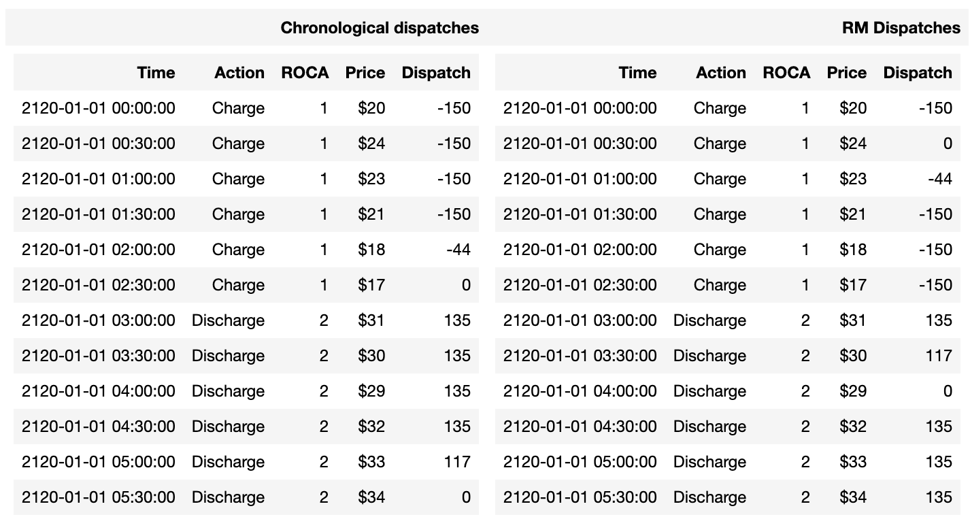
Notes:
Similarly, we can apply this idea to our energy market problem. One way to decide when to charge or discharge is to do it continuously until the storage is full/empty, which is called the chronological dispatches. But this is not ideal.

Slide 11
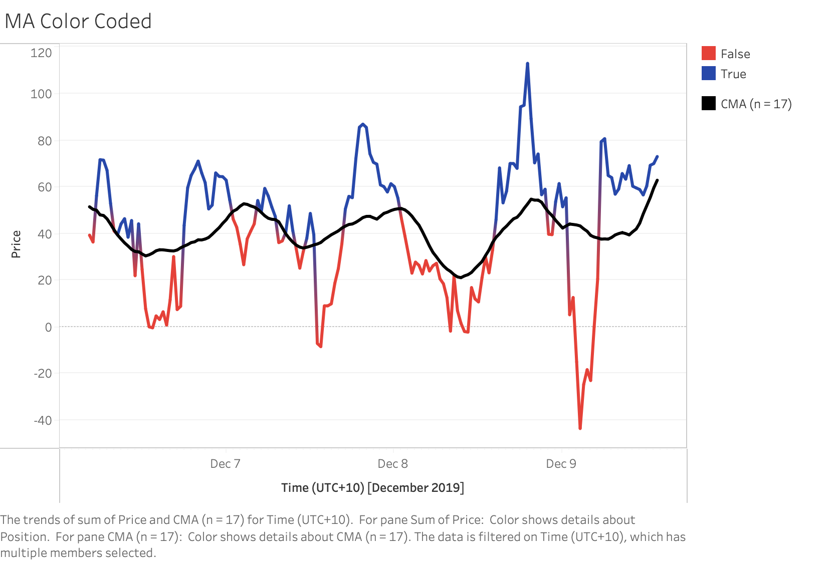
Notes:
From the moving average graph, we will be looking at the period circled, and this is considered as a region of consecutive actions.

Slide 12
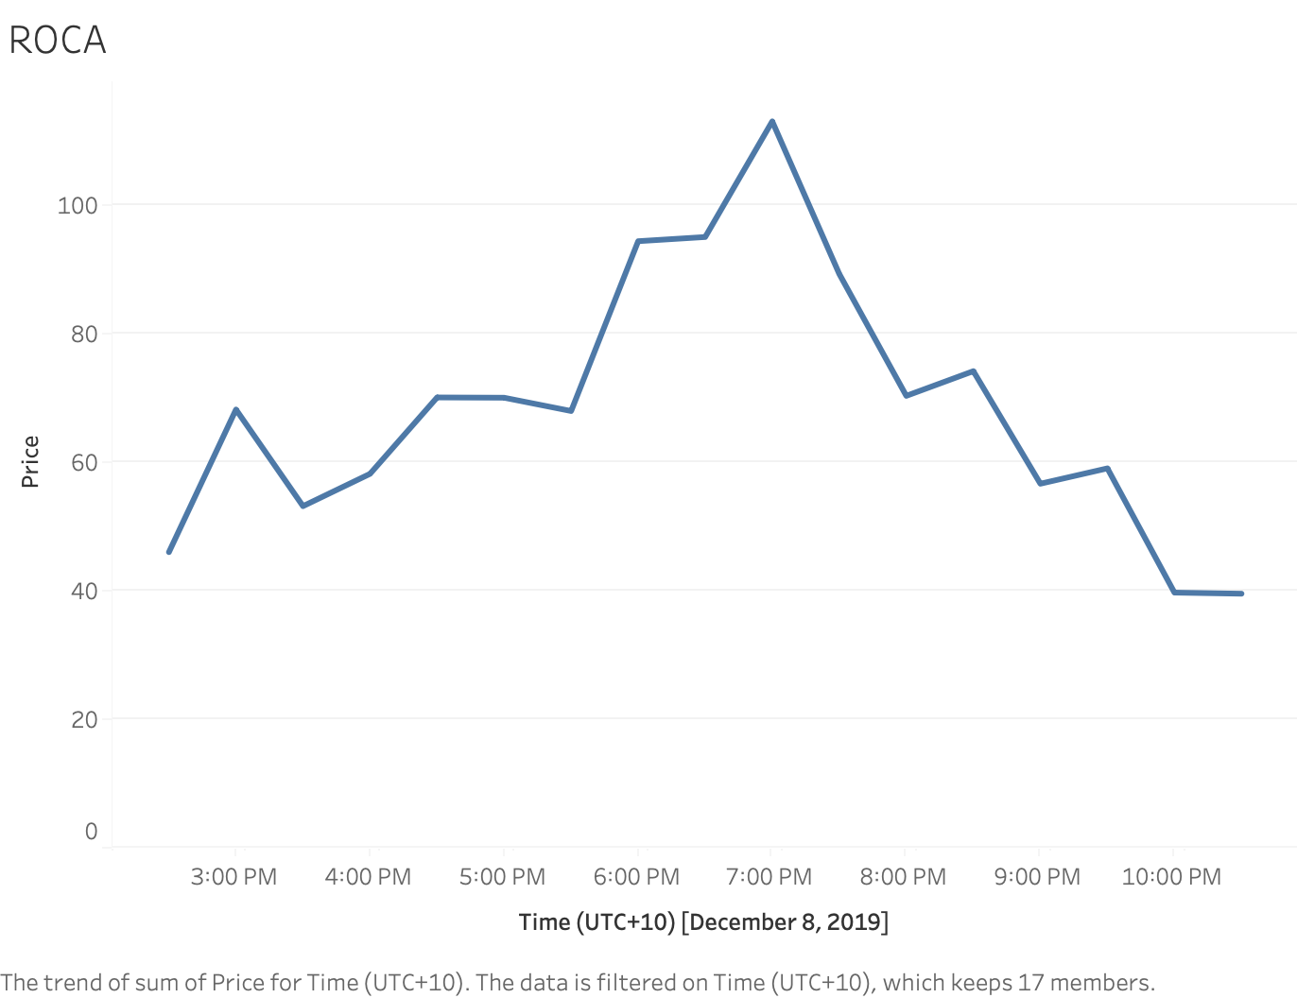
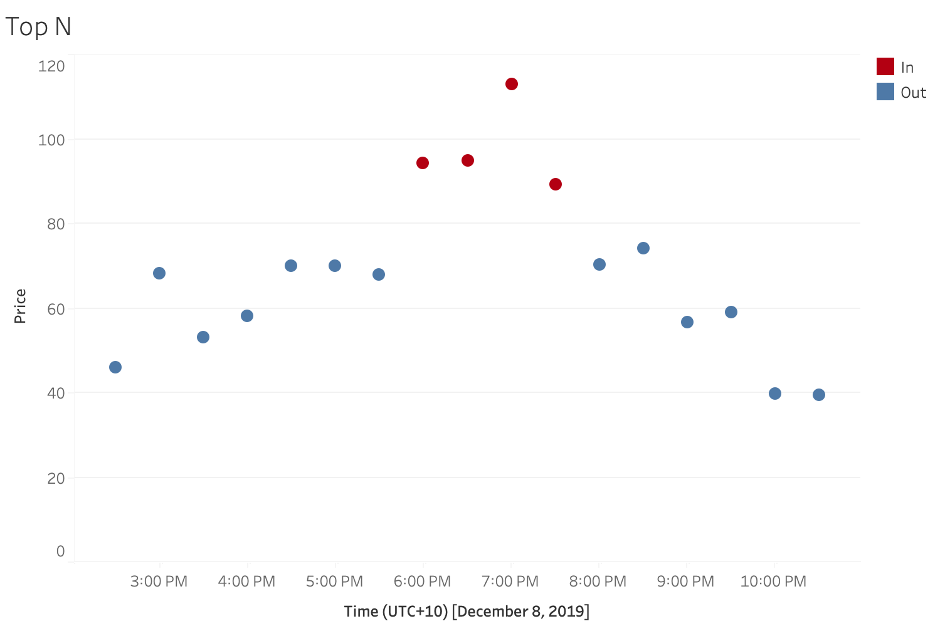
Notes:
On this specific example, we will choose the top 4 prices to discharge.
So, this model looks at each ROCA, sorts the prices in ascending order if we are charging or in descending order if we are discharging and chooses the first N prices until the capacity is full/empty.

Slide 13

Loss Removal

Slide 14
Loss Removal

Slide 15

Stationary Maximization
This Photo by Unknown author is licensed under CC BY-NC-ND.

Slide 16

Stationary Maximization
What does the underlined part mean?
Iterate over all 'Do nothing' time(rows) to take actions on all profitable consecutive charge-discharge transactions.
Consecutive Charge-Discharge Transaction
Profitable Transaction
Discharge price should be > charge price/(0.9^2*0.991^2)
charge at time t and discharge at time t+1 where t+1 is the next one 30-minute time step of t.

Slide 17
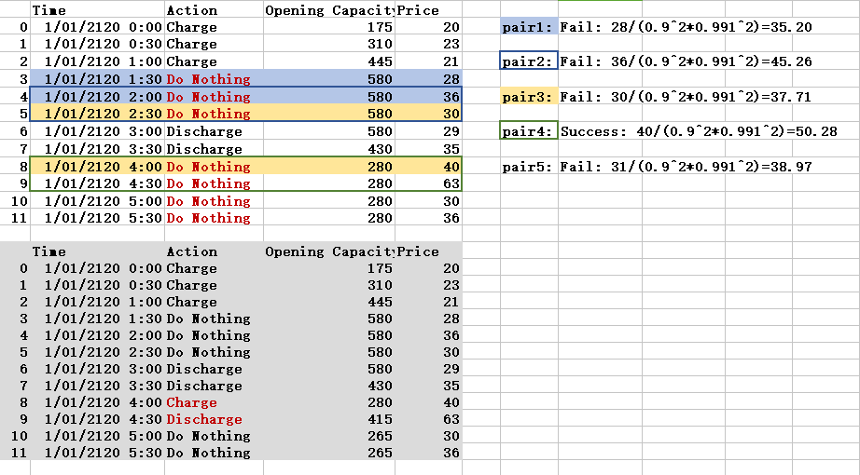

Slide 18

Shift Action

Slide 19

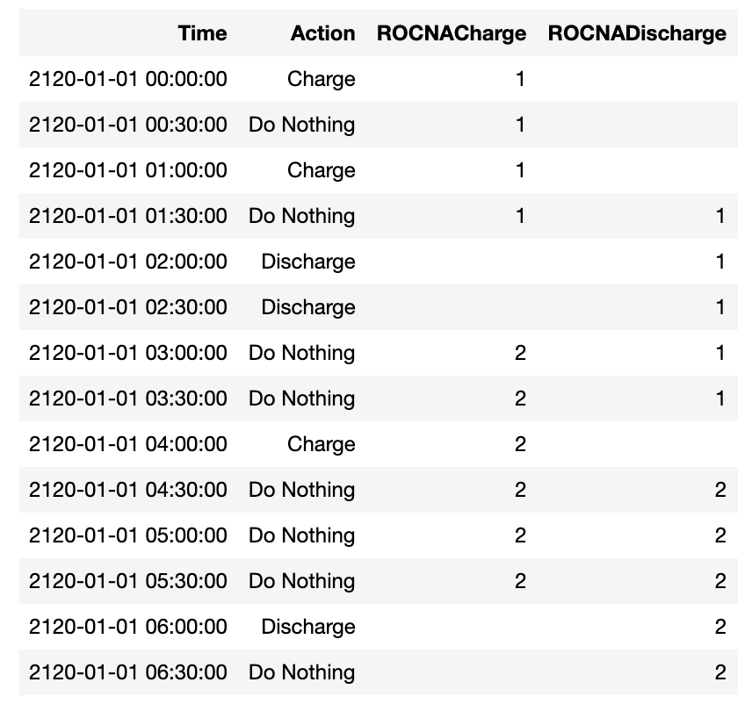

Slide 20

Period Maximization

Slide 21



Slide 22










Periods
1
2
3
4
5
Happiness
5
-5
-2
-1
8
Rules:
To eat 4 snacks, he need to eat at least 5 veggies
Periods
6
7
8
9
10
Happiness
-1
-2
10
-1
6
Best Possible Outcome = 17 Happiness

Slide 23
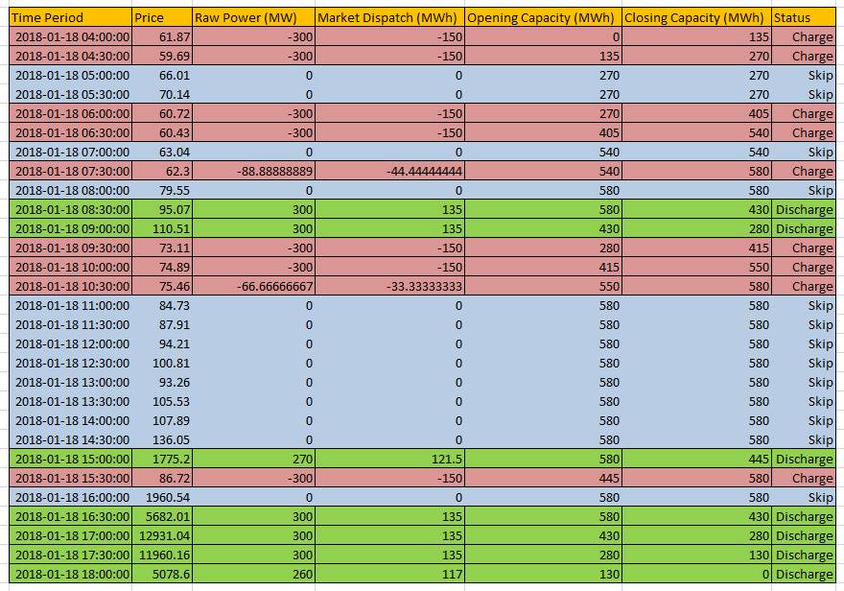
Revenue :
$4,842,737.4

Slide 24

Battery Optimisation Without Future Price Visibility
BONUS TASK

Slide 25

ARMA
1
2
Choose values for order parameters p, q: use ACF plot, PACF plot. sharp spike at lag=1 on PACF plot, exponential-like decay on ACF plot
Test stationary: use Augmented Dickey-Fuller test. our time series data is stationary, we use ARMA instead of ARIMA.
This Photo by Unknown author is licensed under CC BY-ND.

Slide 26

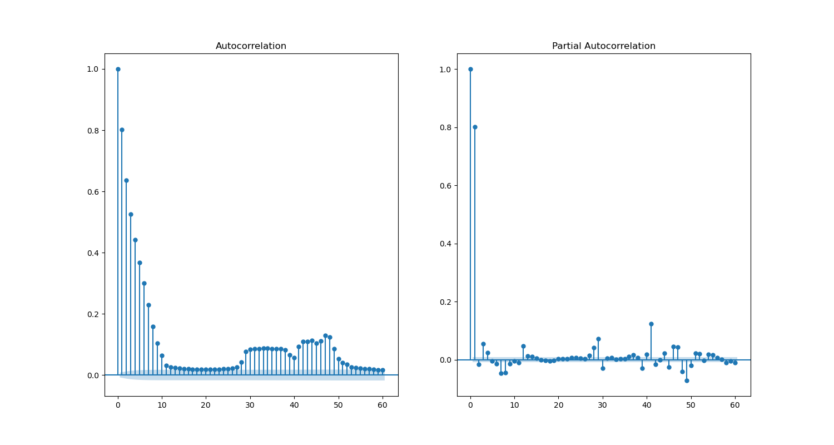
Autocorrelation
Partial Autocorrelation
Lag
Lag

Slide 27

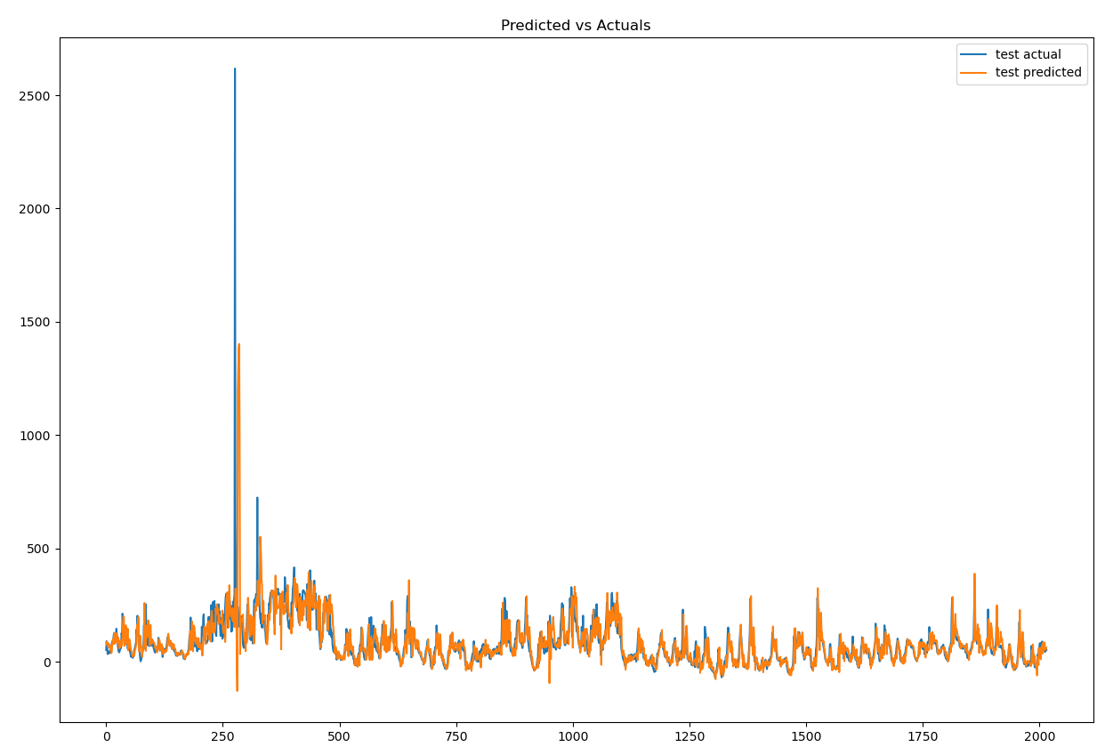

Slide 28

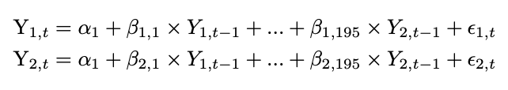
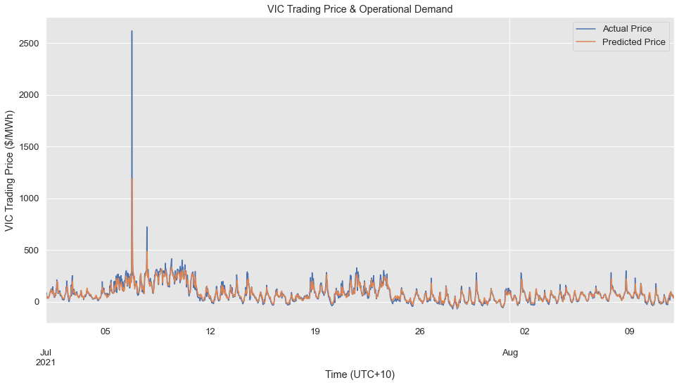
Vector Auto Regression
Victoria Trading Price
Victoria Operational Demand

Slide 29

Performance between Mandatory Task and Bonus Task

Slide 30

Revenue on Test Data Period : 1st July 2021 - 15th August 2021 Using Predicted Price ARMA : $1.696 M VAR : $4.184 M Using Actual Price Total Revenue : $6.018 M
Notes:
(Without period maximisation)

Slide 31

Conclusion
This Photo by Unknown author is licensed under CC BY-NC-ND.
Notes:
Conclusion
To conclude, we decided to use Vector Auto-regression as it is computationally less expensive than ARMA. In the real world, at a given price t, we want to be able to predict the price at time t+1 before we hit the time t+1 hits.
Some limitation of our mandatory task algorithm is that it takes longer to run the algorithm since we are using 6 mini models. For the bonus task, one limitation is that VAR model assumes linearity. Another thing is that if we want to predict the train data itself, the results would not be as good as the test data.
The project is worth pursuing and we would be able to make a website API for users, and it would take around 1 month to deliver the product (?)
That’s the end of our presentation. Thank you for listening.

Slide 32

References
Machine Learning Plus. (2019, July 7). Vector Autoregression (VAR) – Comprehensive Guide with Examples in Python. https://www.machinelearningplus.com/time-series/vector-autoregression-examples-python/
Machine Learning Plus. (2019, November 2). Augmented Dickey Fuller Test (ADF Test) – Must Read Guide. https://www.machinelearningplus.com/time-series/augmented-dickey-fuller-test/
Machine Learning Mastery. (2021, January 2). Autoregression Models for Time Series Forecasting With Python. https://machinelearningmastery.com/autoregression-models-time-series-forecasting-python/

